Slide 1

PRESENTATION ON

Slide 2
PRESENTED TO
MD. Rayhan Ahmed
ID: 181-115-013
&
Jabed Hossain Sujel
ID: 181-115-034
Program: CSE 44th (A)
Metropolitan University, Sylhet

Slide 3
PRESENTED TO
Nusrat Farzana
Lecturer
Department of CSE
Metropolitan University, Sylhet

Slide 4
CONTENT
Introductions
Objectives
Methodology of Library
Motivation of this project
Software Requirements
Scope
Library Management System in laravel
Background of Project
Block Diagram of whole project
Module Description
Future Works
Conclusion

Slide 5
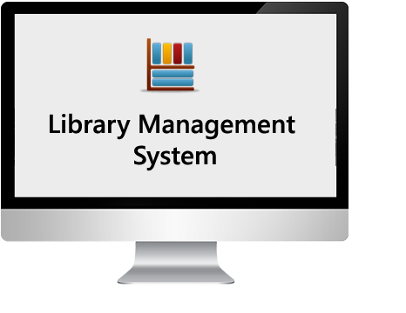

Introduction
Information Technology has revolutionized the life of human beings and has made the lives easier by the several of application. In the light of the rapid changes with the use of IT, there are many tools, technologies and systems have been produced and invented. In the modern world, time is so if there are many processes taken place at same time within a place there is a need for integration of all the processes, creation of paperless environment also ensures efficient task management.
Nowadays all the businesses are shifting to computer based system. The purpose to having a computer based system is, it helps to increase the market share and it’s very easy for customers to use. It is increasing the demand amount the customer. This project is concerned with developing Online Library Management System using PHP and Laravel framework. It’s basically made to track records of find books, issued, find students, etc. In this system the library Management becomes more efficient and easier to handle with its reliable system components.
Here is a brief description of my project, What has been used and what will remain.

Slide 6

Objective
The aim of the project is to prepare a web based automation system for the library with Online Public Access Catalogue (OPAC). And automating the existing system to keep a record of transactions that have taken place on the system.
Basic Objectives
More Accuracy
Speed improvement
Data inconsistency
Better error handling
Integrity
Develop a database which stores user details & item details.
librarian and user should have separate logins.
Create an easy to understand user friendly environment.
Other Objectives
The system will handle the maintenance of data.
It handle entire transaction of book registration till issue of the book.
Administrator will immediately acknowledge with error message.
The administrator details of Books. Authors and existing member etc.
Book wise search can be performed.

Slide 7
Methodology of Library
Library is the place where information and books are stored. It is the place where people from all fields used the books and information required for them. But for that the purpose since long time the manual system was followed during operation using the library card. But with the increasing demands of technology in various fields are forcing to stop the manual system in the library operation. So to fulfill the increasing demands of the library management software has been developed.
Library Management System
(view the book details)
User register
User/student
Librarian
Read & write
Book request/return
Library database

Slide 8

Motivation of this project
To store all information in the database from where user will place their query and get the results on this basis of their query. Only valid users will be able to access this Library Management System. Through this Library Management System it will easy to manage accounts and various details of particular student and librarians working under library along with the records of book.

Slide 9

Software Requirements
Language | PHP
Framework | Laravel
Server | Xampp
Database | MySQL

Slide 10






Scope
This application can be used by any library to maintain the student records, daily transactions of books. There are other opportunities as well:
This project can be used for any company, for infinity number of products, categories as it is totally generic.
The data of the member would be entered in the database.
There would be a safe storage of information of the member in the database. With the database any data can be added, modified, deleted very quickly.
Admin login
Facility to reserve books that are available
A status pages for all users to view books reserved by them
Facility to cancel the reservation for a book made earlier
A status pages for admin to view currently issued logs

Slide 11

Library Management System in
A Library Management System is a project that manages and stores books information electronically according to student’s needs. The system helps both students and library manager to keep a constant track of all the books available in the library. It allows both the admin and the students to search for the desired book. It becomes necessary for all institutions to keep a continuous check on the books issued and returned.

Slide 12
Background of Project
Library Management System is an application which refers to library systems which are generally small or medium in size. In this system, the librarian or the admin will have access to the whole system. The system is user-friendly, and it's easy to use with or without having any knowledge about computer programming. What you just need to know is to understand simple English.
So system let me show you how it's works step by step.
1stly, we need to Register a Librarian or Admin to manage the system.
now I will register the librarian.

Slide 13

Step 1, you need to navigate to register a new librarian or admin, and after seeing the registration page you can add the detail that you want to register with.
After registering the user to manage the system we need to navigate to the login page and enter our login credentials to have access to login onside the system.
After login inside the system, the librarian or admin can able to perform. CRUD operations such as Adding new books, viewing new books, updating new books, and deleting existing books from the system.
The librarian can also able to view all the books that are available inside, inside the library and the librarian can also add the book categories such as.
Fiction or Nonfiction, to categorized the books so that the student's can able to find their interesting books with a single click.

Slide 14

After that, the librarian can also able to add different branches if your school or institution has many branches. And can also able to add student categories if there are any, such as Under Graduate students or Post Graduate students. And can give max the amount for each category to able to borrow books in the library.
On the home page of the system, the librarian or admin can able to find books by entering the book ID to find the book detail inside the system and see if the book is available. And the librarian can also search the Issue book by entering the issue book ID and the result will show the book detail and the student that issued the book from the library.
The librarian can also able to search students by entering the student ID to find the specific student from the system, if the student is approved or not been approved yet. Based on the result the librarian can print the result as PDF or can able to send an email to the student if the books that they took it's not been returned yet.

Slide 15

After that the librarian or admin can able to issue the books that the student requested by using the issue or return book form.
After that the librarian or admin can also able to approve the students who already register to access the library books.
After that the librarian or admin can also able to see all the registered students.
Now let's move to the student section, where the students can able to register, to the library as a member, and after registering to be a member, the student will wait, his or her approval from the librarian or the admin to approve the student that already register.
After the librarian approved the student, the student can able to have access, to request any books from the library.

Slide 16
After that the student can also able to search for books from the home page of the system, and see if the book is available or not, if the book that the student is trying to borrow is available.
Then the student can proceed else the student can wait till the books are available in the library.
All these modules are help able to help librarian to manage the library with more convenience and in a more efficient way as compared to library systems which are not computerized.

Slide 17
Module Description
Online library management system divided in two modules –
Group A
Admin
Group B
Student

Slide 18
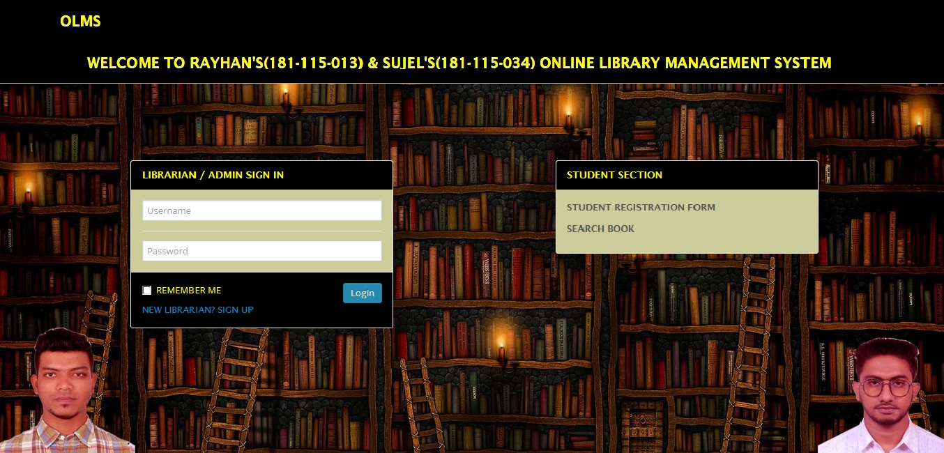
Home Page On The Project

Slide 19
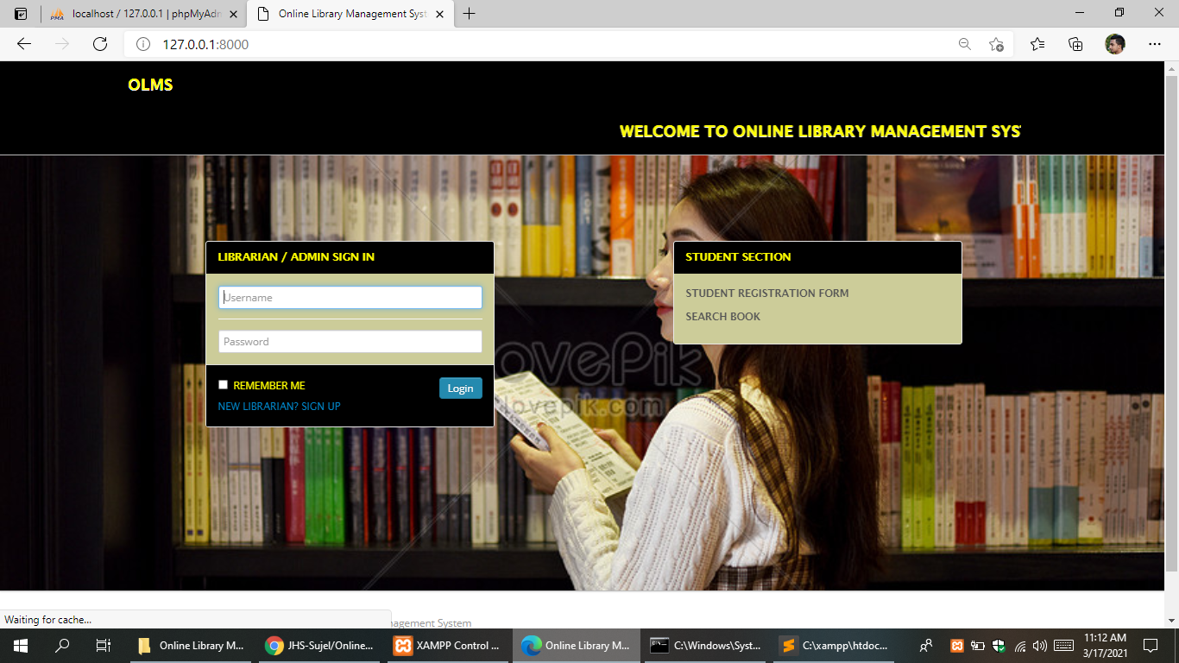
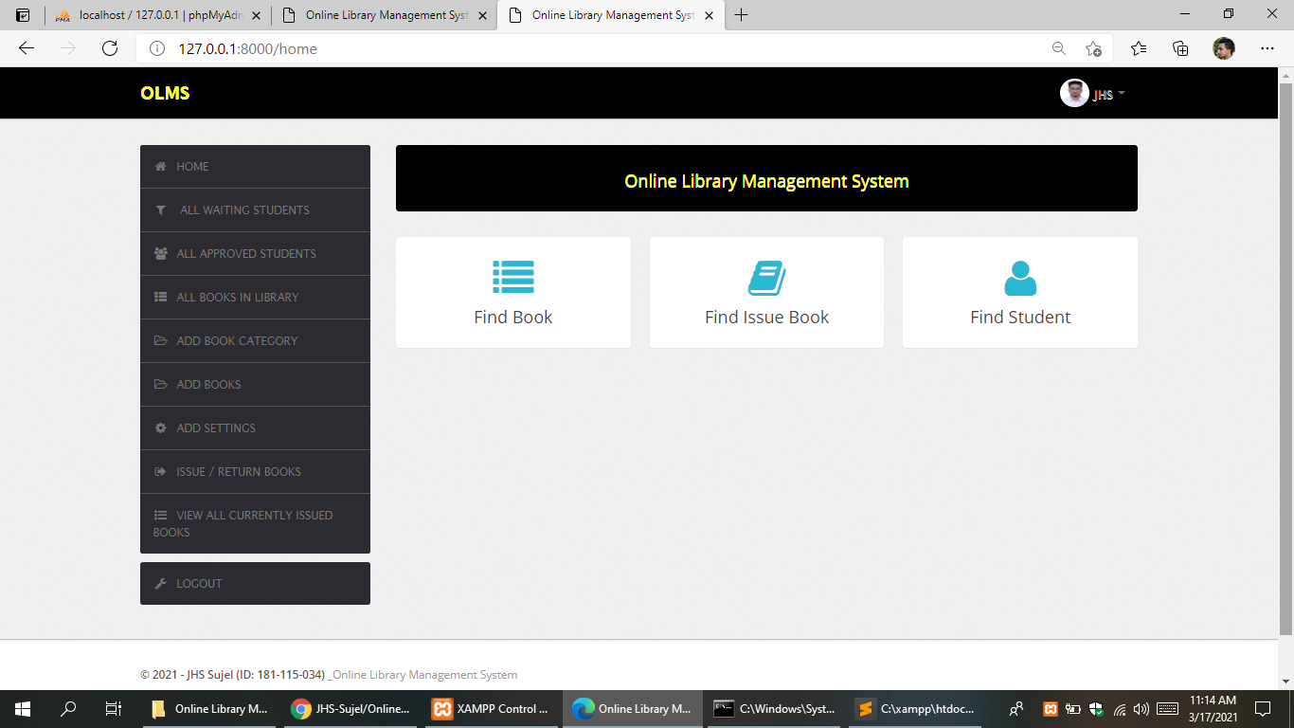
Admin Modules
Librarians can be given there authorized login ID and password without which the system can’t be accessed or you can login by registering a new id by signing up.
After login librarians can search for a specific book, book issue or student from the home panel. Librarian can search student by using their student ID.

Slide 20
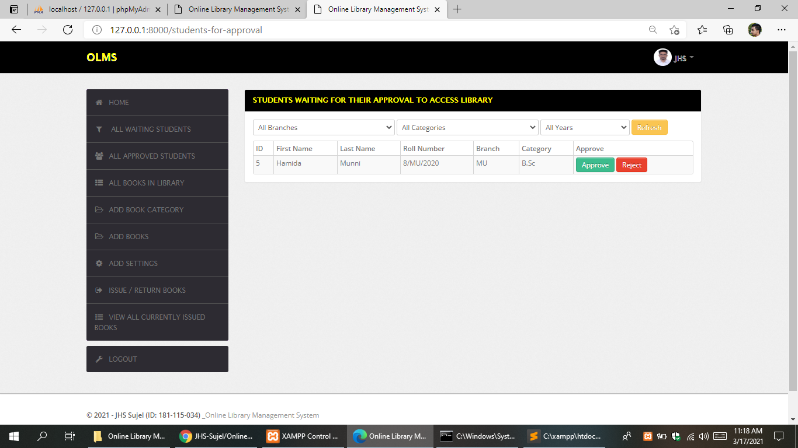
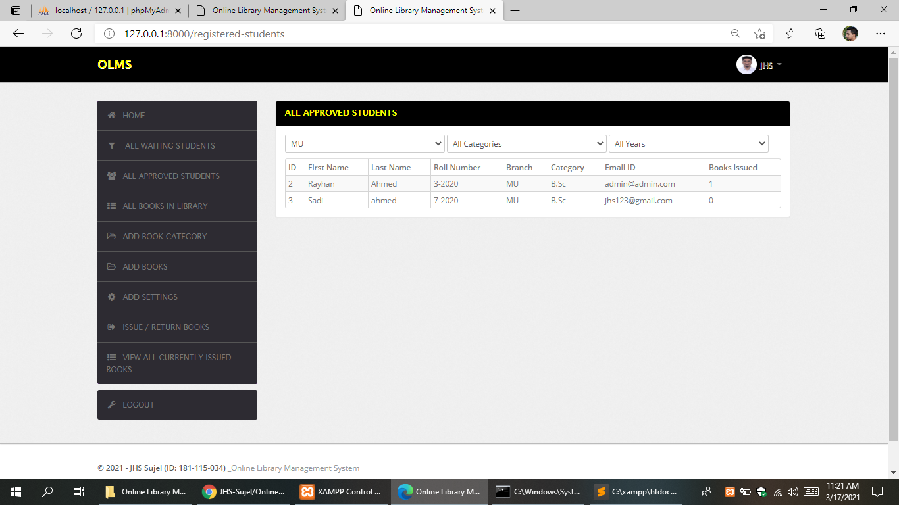
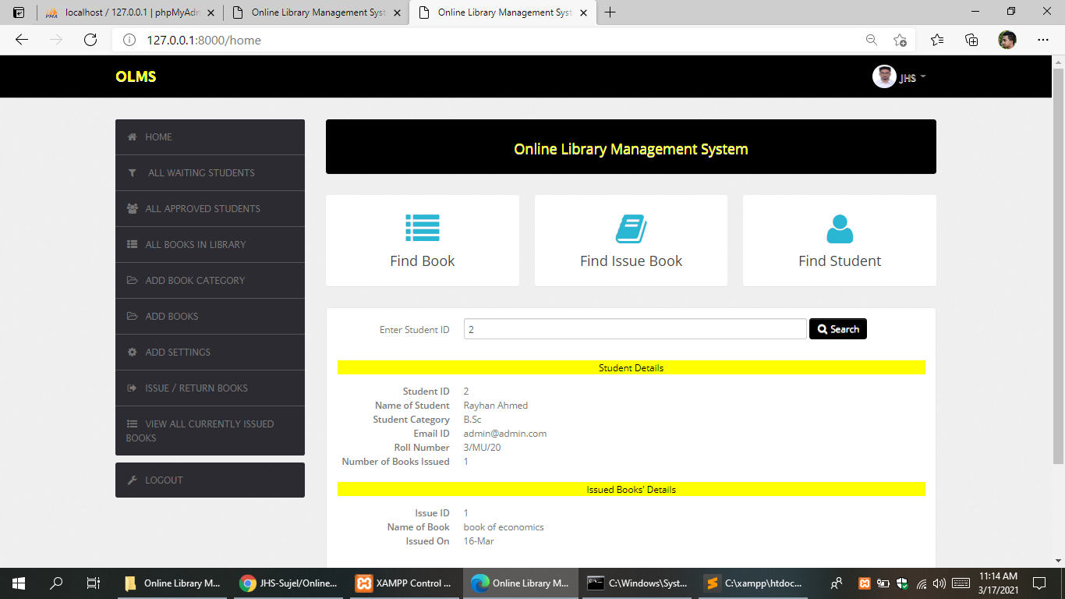
Another responsibility of a librarian is to approve students in situations where approval is needed, i.e. where documents are to be verified or some manual work. Librarians have a panel to simply approve/reject students and to view all approved students. The librarian ID is stored alongside each approved/rejected student to keep track.

Slide 21
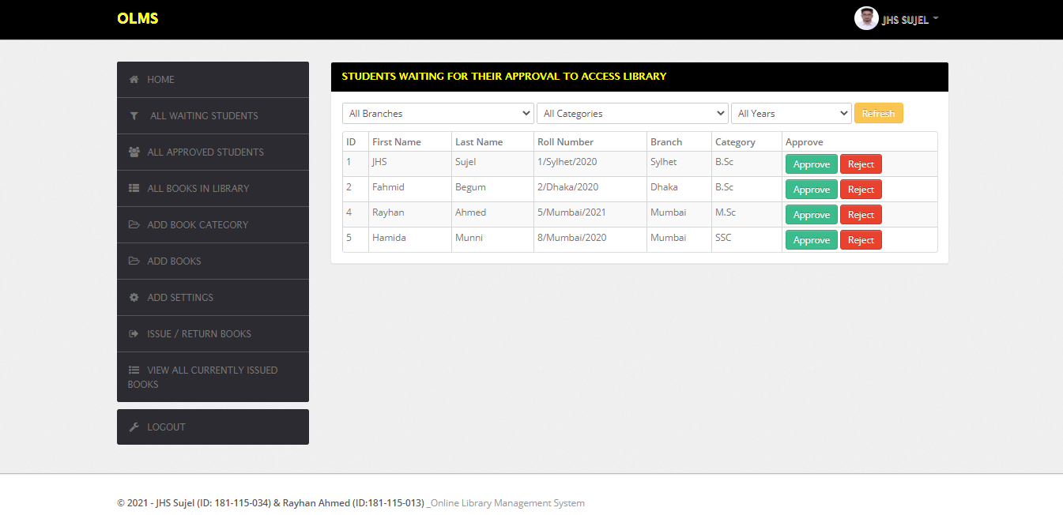
All waiting Students. The admin can approve or reject a student in this menu

Slide 22
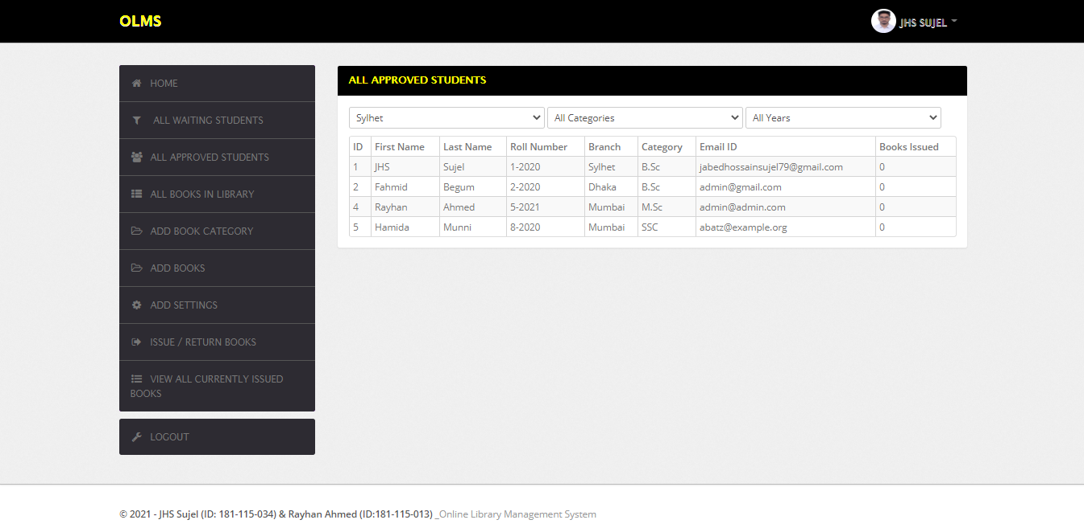
All Approved Students. A list of all students is displayed here.

Slide 23
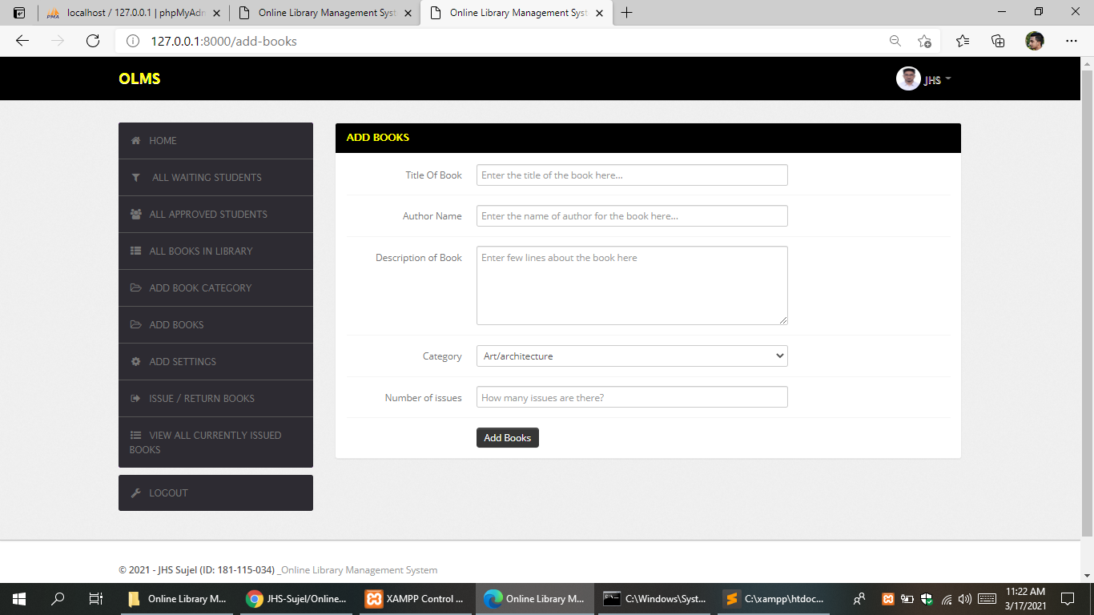
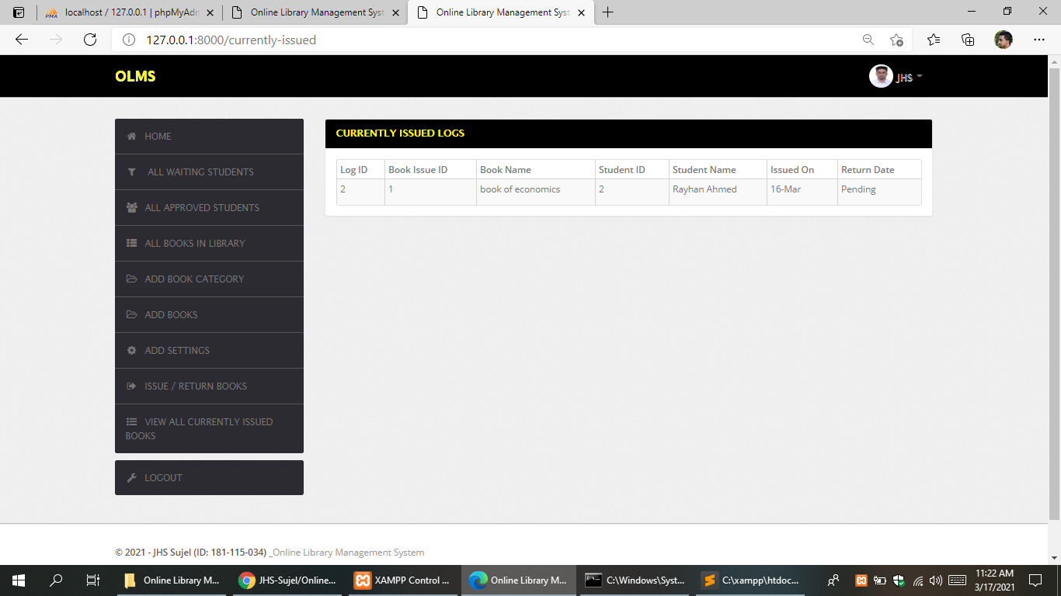
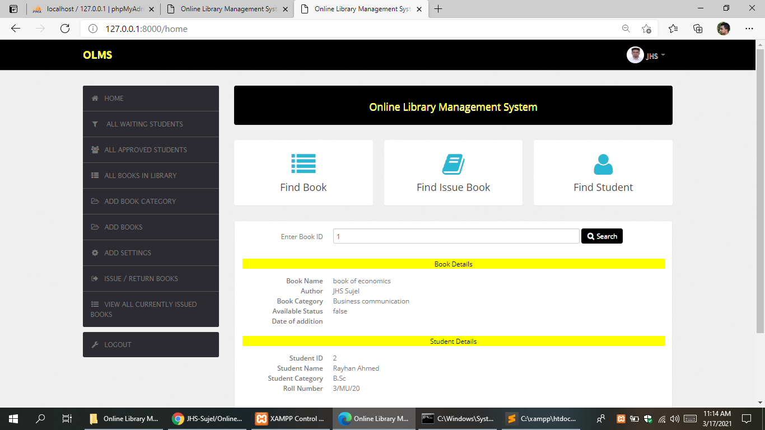
Librarians need to make an entry for the new books. To automate the process they simply need to enter the number of issues, then the issue ID for each book issue is generated automatically.

Slide 24
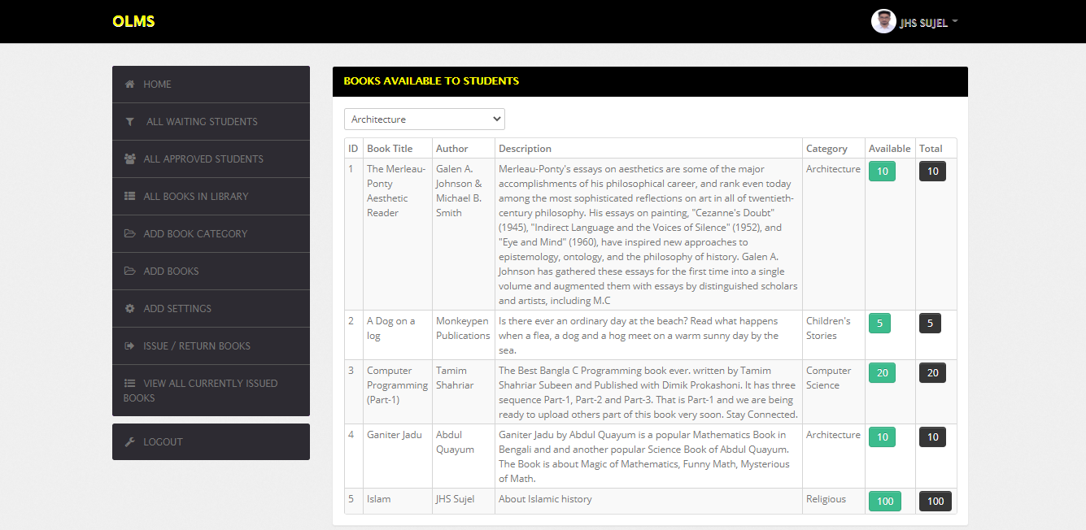
All Books In Library. A list of all book are available in library, is displayed here

Slide 25
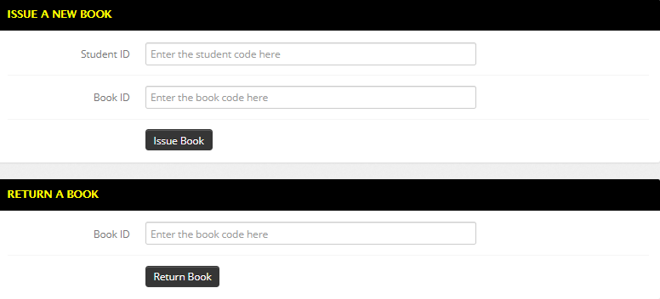
The most important function of any library is to issue and return books. This system includes a panel to view all outstanding logs and a super simple panel to issue and return books for all librarians.

Slide 26
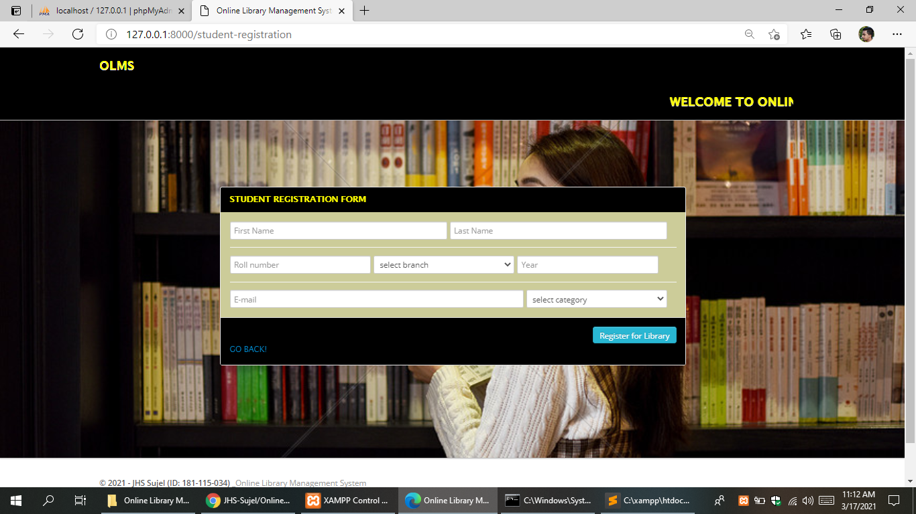
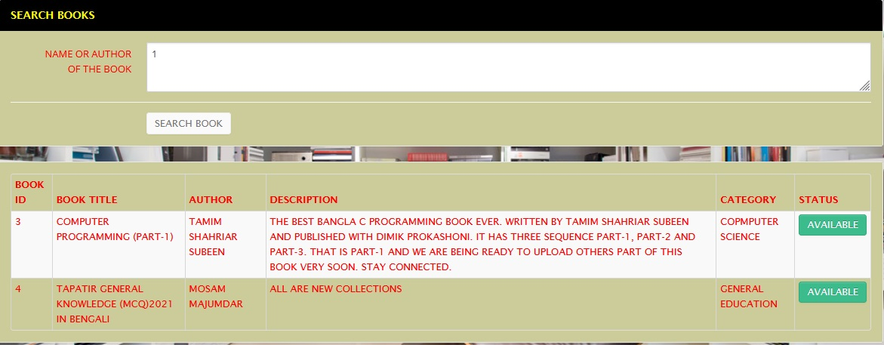
Student Modules
Students can only access limited features, i.e., public access level features which include searching a book and student registration form.
Student can register yourself and after registration they will get student ID.
Student can view issued book.

Slide 27
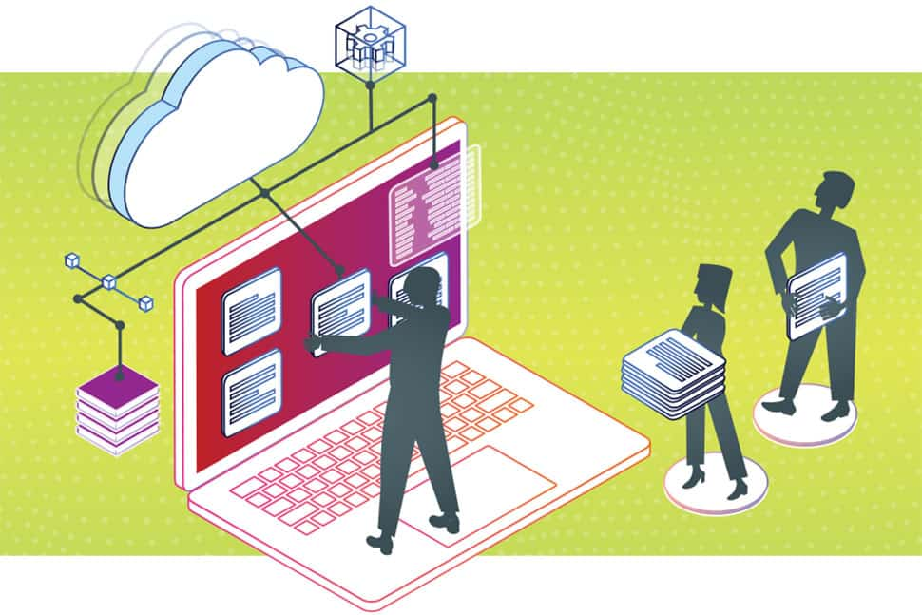
Block Diagram of whole project
Initialization Interface
Search Book
Student Registration
Login
Server Error
Select Function
Logout
Home
All Books in Library
Add Settings
Find Book
All Approved Students
Issue/Return Books
Find Student
All Issued Books
Add Books Category
Find Issue Book
Student Registration
All Waiting Students
Fig: Block Diagram of system structure

Slide 28
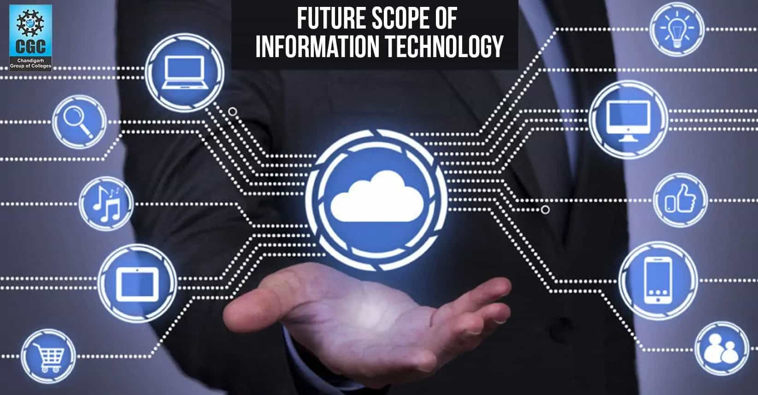
This application can be easily implemented under various situations. We can add new features as and when we require. Reusability is possible as and when require in this application. There is flexibility in all the modules.
It is not possible to develop a system that makes all the requirements of the user. User requirements keep changing as the system is being used.

Slide 29
Some of the future enhancement that can be done to this system are:
As the technology emerges, it is possible to upgrade the system and can be adaptable to desired environment.
Based on the future security issues, security can be improved using emerging technologies
Sub admin module can be added
Multiple users can login at same time
Database records shall be encrypted so that it was not read by user while accessing the database directly into the software
There is no module called teachers in this project, where a teacher can add his lectures and give different types of suggestions, can take online based assignments. So we will add this feature in future.
A feature Of group chat where students can discuss various issues of engineering can be added to this project thus making it more interactive more user friendly and project which fulfills each users need in the best way possible

Slide 30

Conclusion
The Library Management System needs to be computerized to reduce human errors and to increase the efficiency. The proposed Library Management System in this proposal will be a computerized management system developed to maintain all the daily work of library. Library management systems are designed to store all the information about books and members.
The main focus of this project is to lessen human effort and encourage efficient record keeping.

Slide 31


